Slide 1
Oil production prediction
IHS interview
Yan Xu

Slide 2
Outline
Part 1 | Summarizing the result
Part 2 | Understanding data and changing data type
Part 3 | Processing missing data
Part 4 | Finding critical variables
Part 5 | Building training model
Part 6 | Shortcomings and Future work

Slide 3
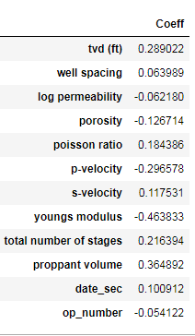
Part 1. Summarizing the result
Using multi-linear regression model to predict oil production
Y= -1.7*e^(-16) + 0.29*tvd(ft) + 0.06*well spacing - 0.06*log permeability - 0.13*porosity + 0.18*poisson ratio -0.3*(p-velocity) + 0.12*(s-velocity)-0.46*youngs modulud + 0.22*total number of stages + 0.36*proppant volume + 0.10*date_sec - 0.05*operator
Note:
‘date_sec’ is the unix timestamp second
‘Operator’ was the label number of operator

Slide 4
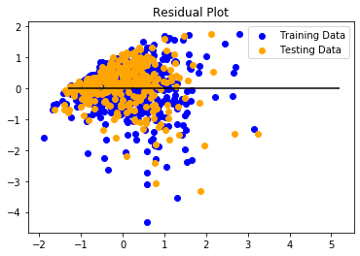
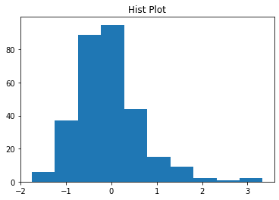
Part 1. Summarizing the result
histogram of the residuals
mean_squared_error: 0.5
Mean_absolute_error:0.5
R²: 0.54

Slide 5
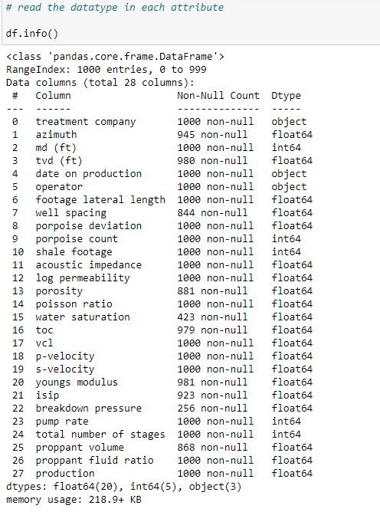
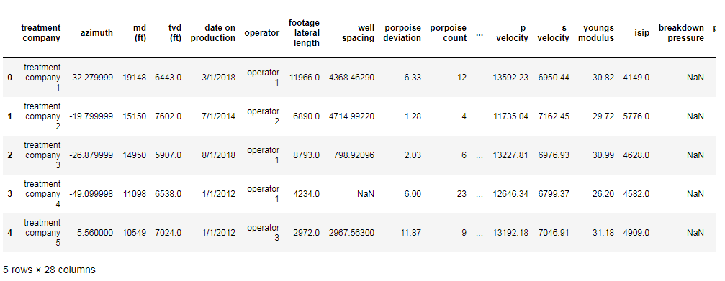
Part 2. Understanding data and changing data type
For linear regression: change the object into int

Slide 6
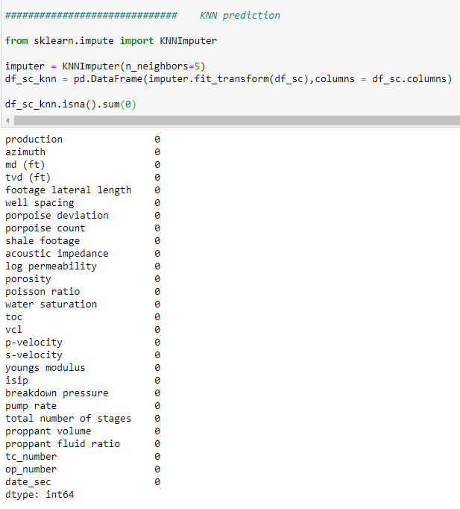
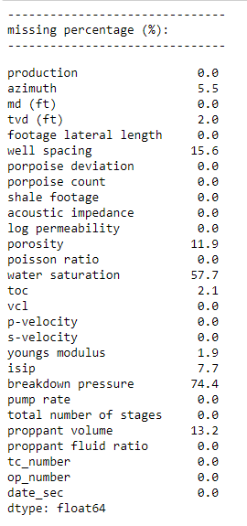
Part 3. Processing missing data
Using KNN model to prediction the missing data

Slide 7
Part 4. Finding critical variables
Critieria:
Using |P| value
according to reference, if |P value| < 0.05, the feature is significant
to be conservative, we choose |P value| < 0.2, and delete the value =>0.2
Using variance inflation factor (VIF)
Multicollinearity occurs when two or more predictors in the model are correlated
it provide redundant information about the response
Multicollinearity was measured by variance inflation factors (VIF) and tolerance
VIF >10 is not acceptable
Using correlation
the coefficient returns a value between -1 and 1
the value represents the limits of correlation from a full negative correlation to a full positive correlation
according to reference, |value| <0.1 means weak correlation
to be conservative, we choose |value| <0.01
Using Adj. R-squared
The selected variables should increase adj R2

Slide 8
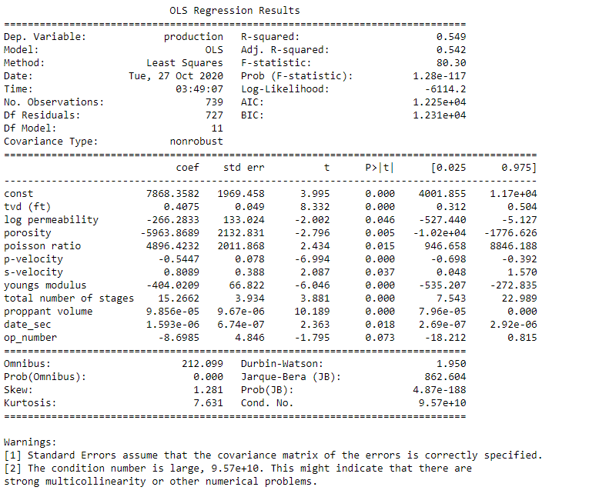
Part 4. Finding critical variables
After several test, the following variables are selected:
# 'tvd (ft)',
# 'well spacing',
# 'log permeability',
# 'porosity',
# 'poisson ratio',
# 'p-velocity',
# 's-velocity',
# 'youngs modulus',
# 'total number of stages',
# 'proppant volume',
# 'date_sec',
# 'op_number'

Slide 9
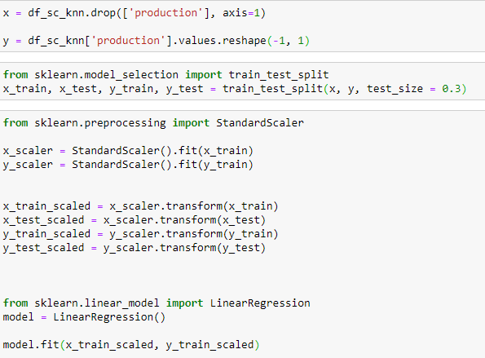
Part 5. Building training model

Slide 10
Part 6. Shortcomings and Future work
If time allowed, I can to the following:
Explain each variables
Learn from the related publications to justify the selected variables
Explain why the variable matters
Improve R^2
Using deep learning model to improve the fitting
Use fixed effect to test the operator and time effect

